Slide 1
Python tkinter with MySQL database
Submitted By Devanshi Tegwal
Under the guidance of
Mr. Tanay Kishore Mishra

Slide 2
Table of Content
Introduction
MySQL Connector
Problem Statement
GUI Results
Operations Performed
Conclusion
References

Slide 3
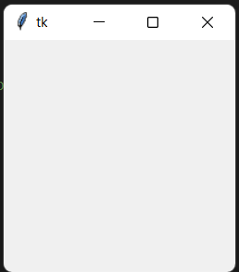
Introduction
Tkinter is a GUI that python offers. Creating a GUI using tkinter is very easy.
To create a tkinter app:
Importing the module – tkinter
Create the main window (root = Tk())
Add any number of widgets to the main window.
Apply the event Trigger on the widgets (root.mainloop()).

Slide 4
MySQL Connector
To create a connection:
import mysql.connector mydb = mysql.connector.connect( host="localhost", user="yourusername", password="yourpassword" ) print(mydb)

Slide 5
Problem Statement
GUI based windows application with the integration of MySQL using the python Tkinter module.

Slide 6
Inputs
Buttons
Widgets
Enter ID
Enter Name
Enter Phone
Insert
Delete
Update
Get
Label() Button()
Entry()
Place()
Grid()

Slide 7
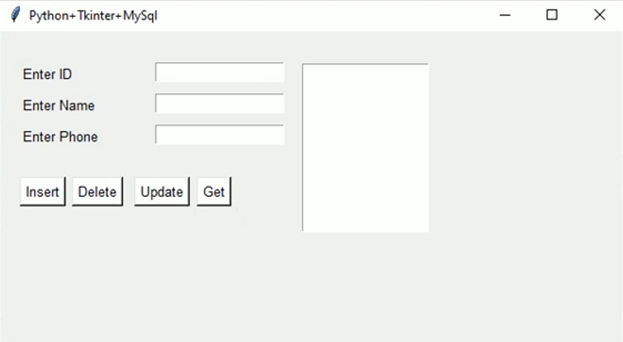
GUI Results

Slide 8
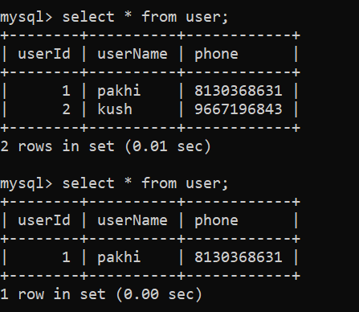
Operation performed
Data Stored
Insertion
Deletion
Upgradation

Slide 9
Conclusions
Data is stored in the Database
Insertion, deletion, upgradation is possible by simple click

Slide 10
References
https://www.geeksforgeeks.org/python-gui-tkinter/
https://docs.python.org/3/library/tkinter.html

Slide 11
Thank You

